Slide 1
Introduction to Angles

Slide 2
Key Vocabulary
Ray- a part of a line that has one endpoint and extends indefinitely in one direction through another point.
B
Symbol: $\vec{AB}$
A

Slide 3
Key Vocabulary
Opposite rays- two rays that share a common endpoint and all points on both rays are collinear.
B
A
B
C
C
A
Not opposite rays since point A and point B are not collinear.
Symbol: $\vec{CB} and \vec{CA}$ are opposite rays

Slide 4
Key Vocabulary
Angle- formed by two noncollinear rays that have a common endpoint (if they were collinear this would just be considered a line)
Symbol: $∡CAB or ∡BAC$
C
B
A

Slide 5
Naming Rays and angles
Notes for Naming Rays:
Notes for Naming Angles
B
A
C
B
A
Symbol: $\vec{AB}$
Symbol: $∡CAB or ∡BAC$

Slide 6
Naming Continued
C
B
A
D

Slide 7
Angles Measures and Classifying Angles
Angle measure are based around a circle which has 360 degrees. Degrees are the unit of measure used to measure angles; however, there is also another unit of measure that can be used called a radian. We will use degrees in Geometry.
Acute Angles | Right Angles | Obtuse Angles

Slide 8
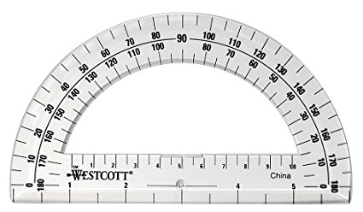
Measuring angles with a Protractor
Click the protractor below to watch the video

Slide 9
Drawing Angles using A protractors

Slide 10
Congruent Angles
Congruent Angles are two or more angles that have the same measure.

Slide 11
Angle Bisector
Angle Bisector is a ray (most often) or line that cuts an angle into two congruent angles.

Slide 12
Example 1

Slide 13
Example 2:

Slide 14
Example 3:

Slide 15
Remember Pictures are just to help us set up the math correctly they do not have to be accurate

